Slide 1

Real Estate Data Analysis
Melissa Djohan
Limei Hou
Indira Poovambur

Slide 2
Core Message/Hypothesis:
Times are changing — and at a much faster pace than ever have before.
PyConstruction Inc., a burgeoning construction company based out of New York is specializing in building "live work and play" communities. In their most recent efforts,
they've started tackling first part of the paradigm "live" by compiling real estate data from cities to find out what Americans like the most when it comes to living
and how much are they willing to pay.
Our objective is to analyze the data and assist PyConstruction Inc. in coming up with a good plan.
We wanted to find out if our randomly picked three cities would have any sort of correlation.
The main question we wanted to answer is:
Is there a significant difference in average yearly market value between the three cities, using significance level α = 0.05?

Slide 3
H_{o}: H_{A}:

Slide 4
Other questions we wanted to answer in the process:
What are other factors that go into the market value of a home?
Room count?
Bedroom count?
Bathroom count?

Slide 5


Slide 6
Data Exploration and Clean-up Process:
Dropped the data frame from 124 to 12 columns
Renamed columns to more meaningful names
In some cases sorted the columns
In some cases converted the data type to facilitate sorting of the column

Slide 7
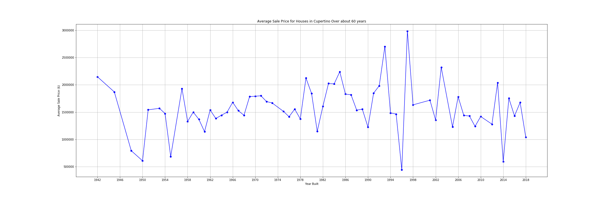
Are the houses selling?
Cupertino
Avg price between 1 to 2 M, drop from their 3 M.

Slide 8
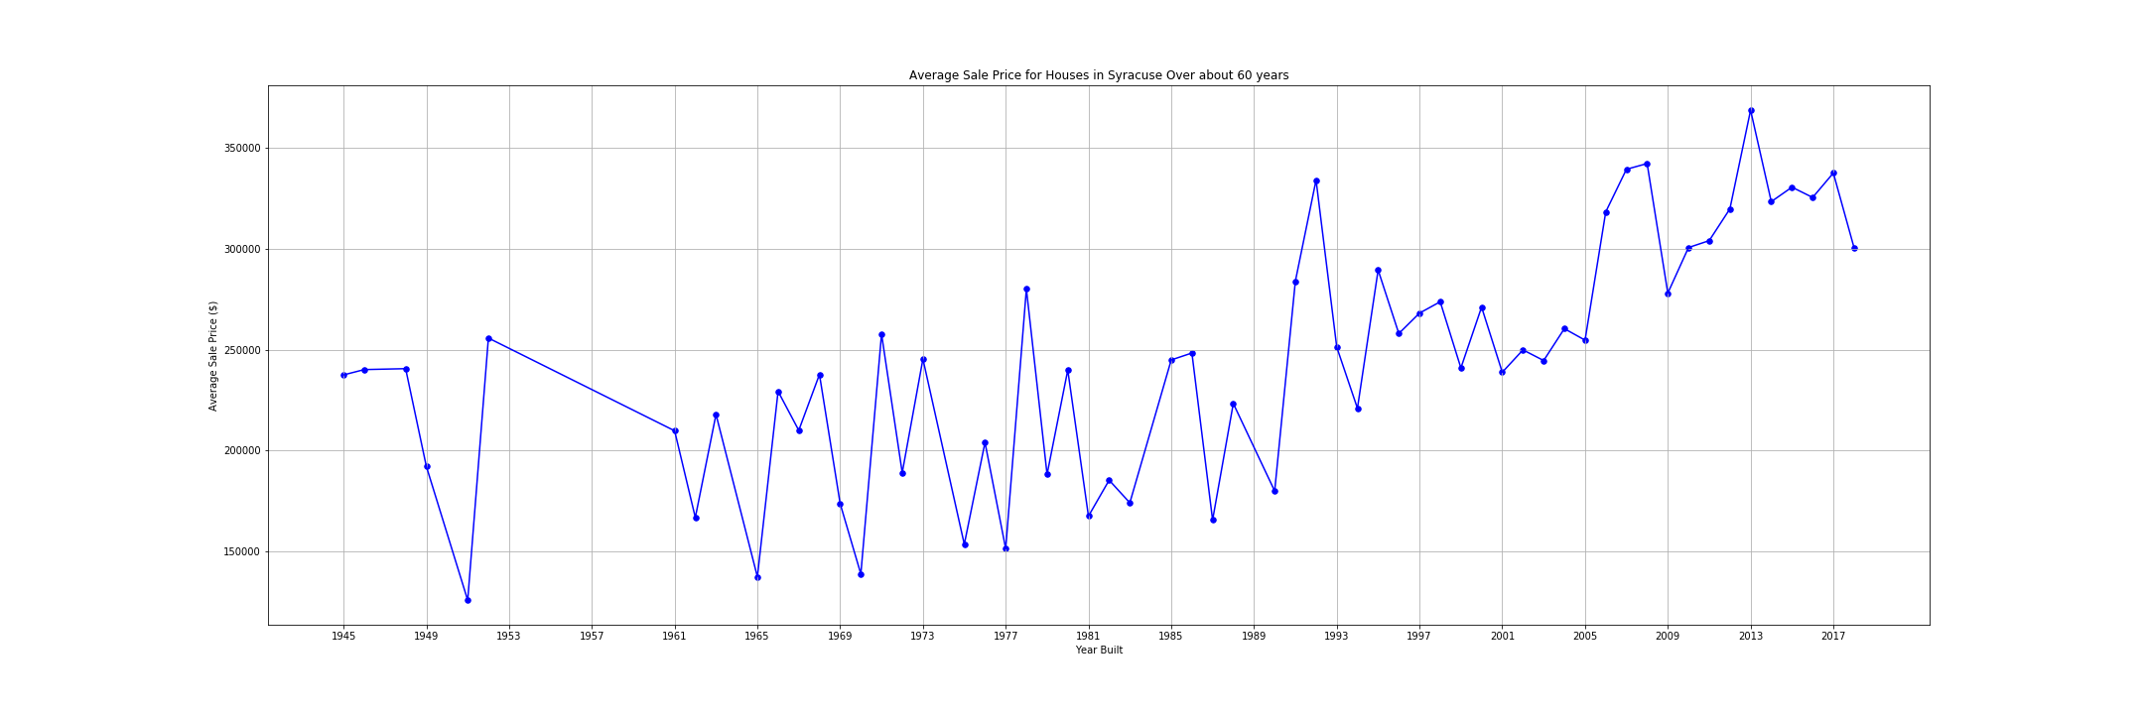
Are the houses selling? (cont.)
Syracuse
The market looks good here, the average price has gone up and is at a all time high.

Slide 9
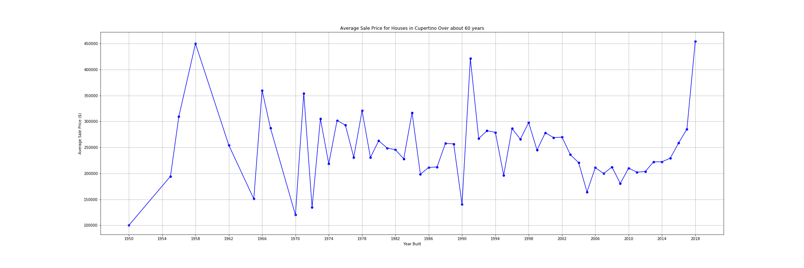
Are the houses selling? (cont.)
Austin
The market looks good here, the average price has gone up and is at a all time high at 450K.

Slide 10
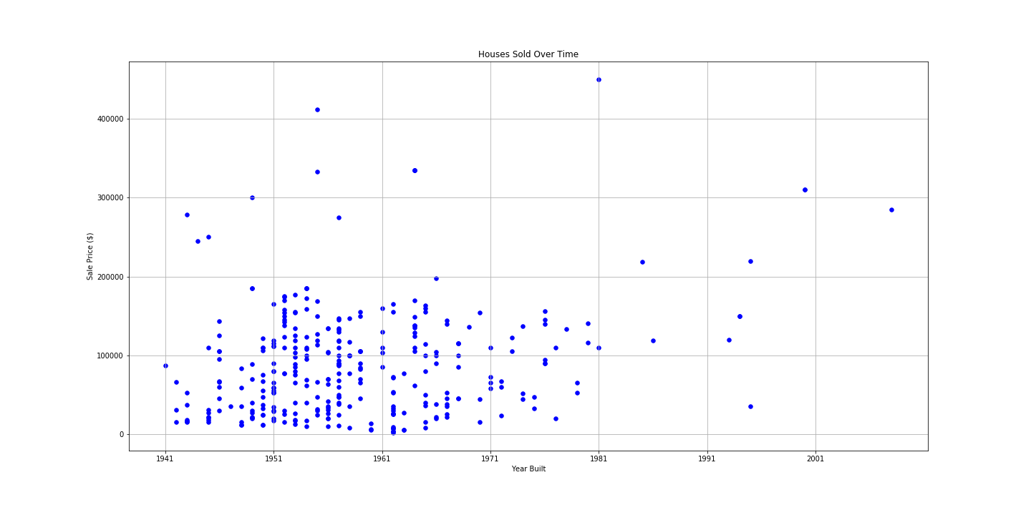
Are the houses selling (contd.)
Chicago
No. Overall a bad housing market, so no further analysis conducted.

Slide 11
What sold the most?
So, based on room count, bedroom count and bath count here’s our findings:
Cupertino: 8 rooms, 3 bedrooms,2 baths.
Syracuse: 6 rooms, 2 bedrooms, 2 baths.
Austin: No data room on room count or bedroom count, 2 baths.

Slide 12
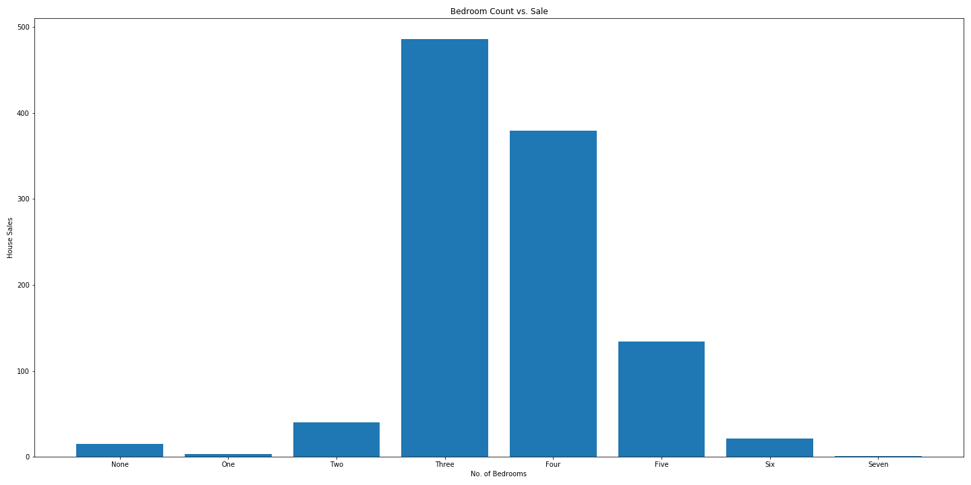
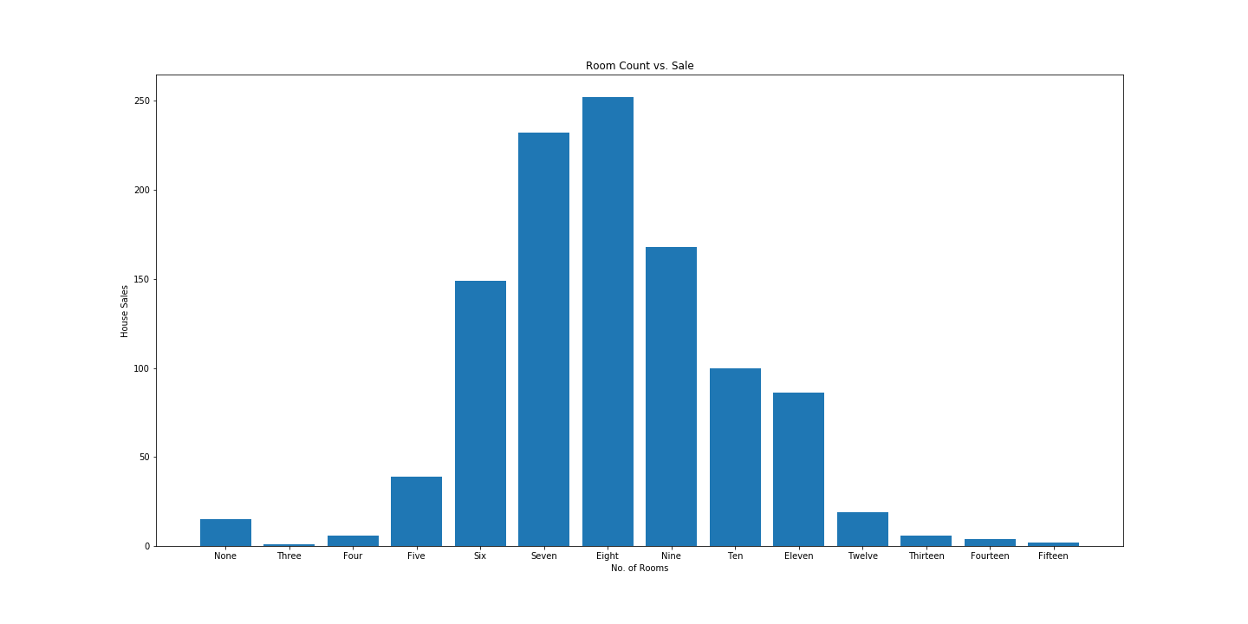
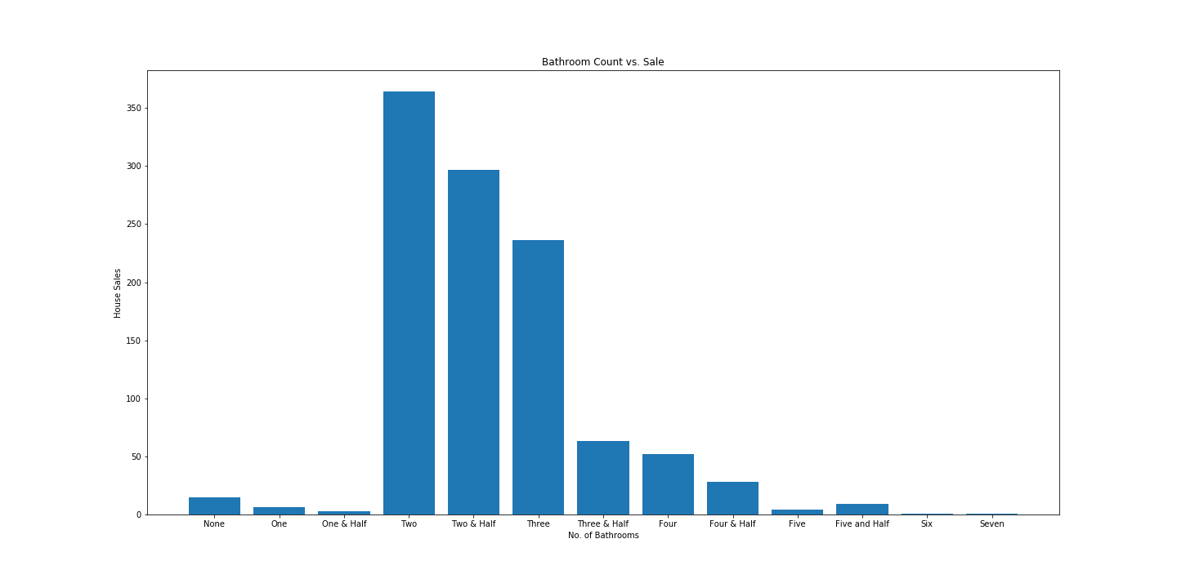
Cupertino

Slide 13
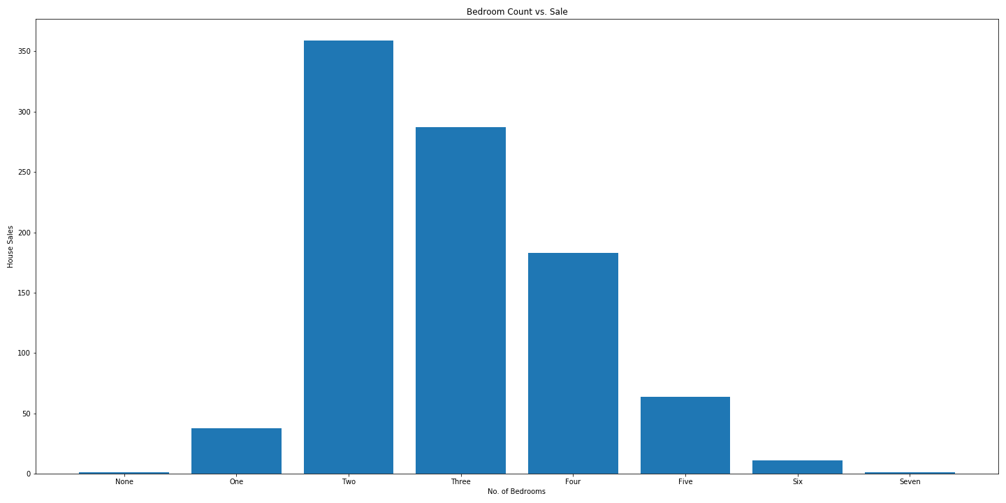
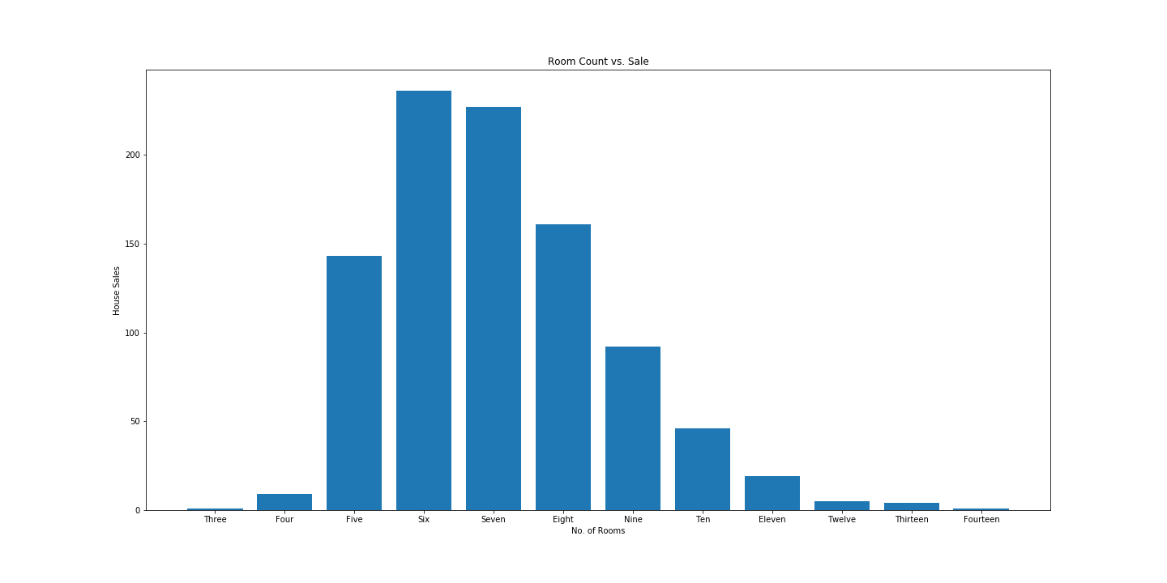
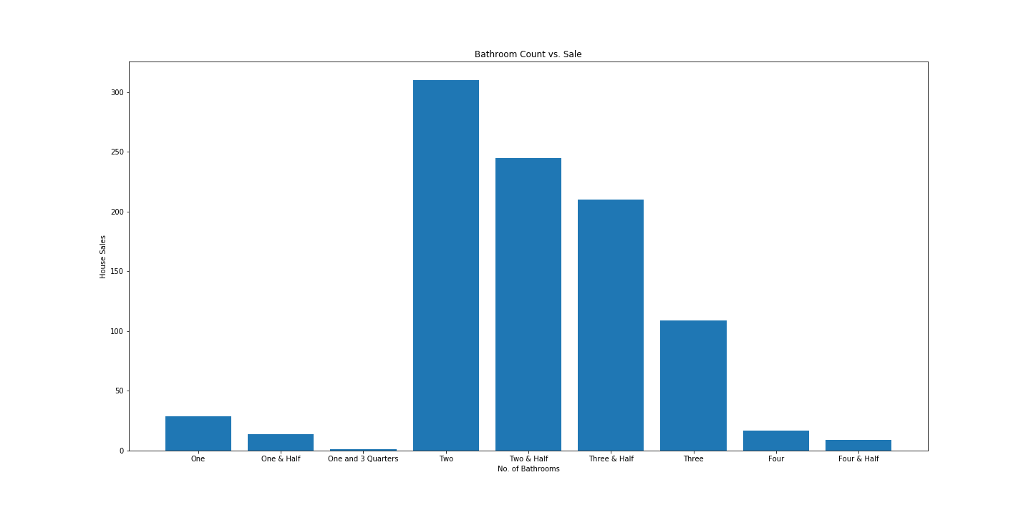
Syracuse

Slide 14
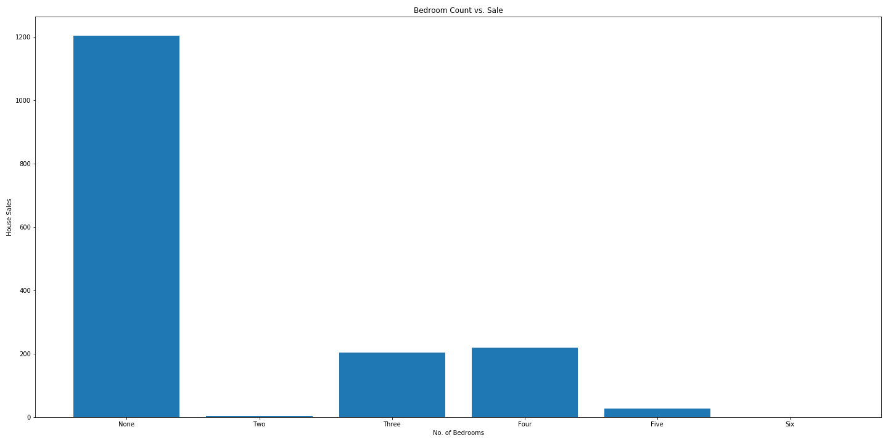
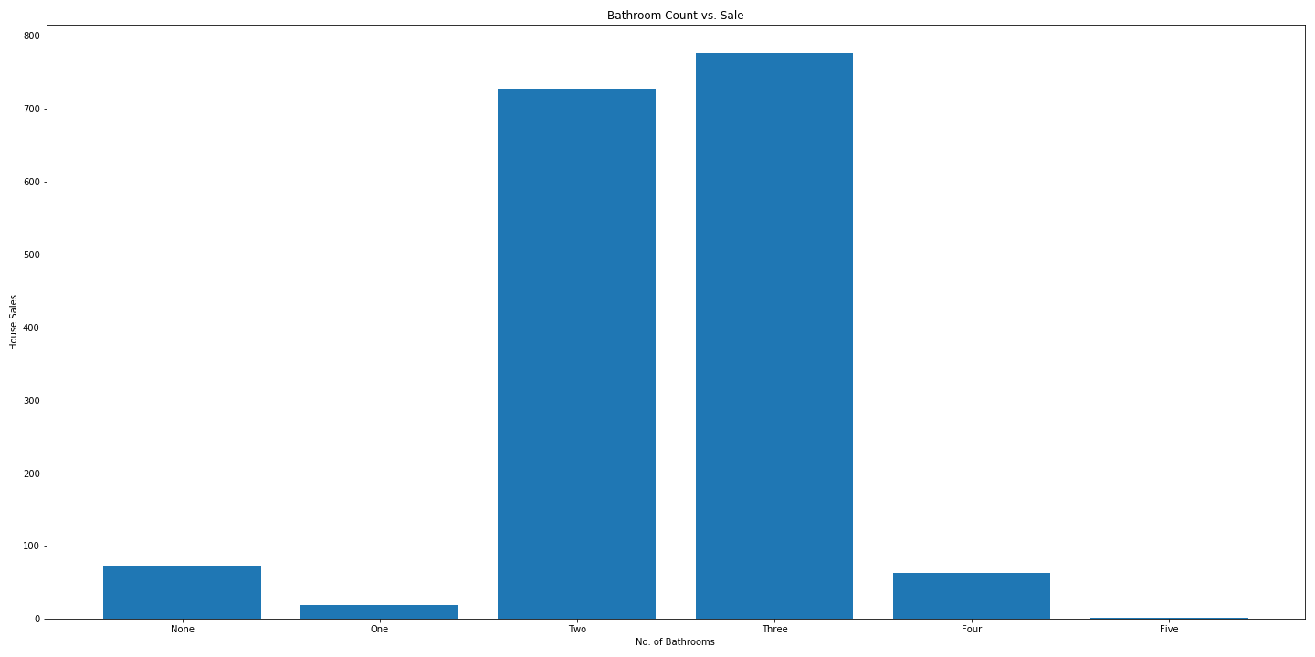

Austin

Slide 15
The Story:
Austin and Syracuse are top markets. People generally prefer mid size homes with 2 baths.
Is America ready for live work and play community?
…Further analysis is required.

